Slide 1
Art Museum Database
Dylan Weinmann and Kenneth Aldridge

Slide 2
Our Project
Art Museum Database
Intended to store all relevant information about an Art Museum
Visitors to the museum and their visit times
Employees, what they do, and their hours worked
Art pieces inside the museum and that artists that created them
We did not source our data through any website, instead just created realistic data to fill out the database
We used MySQL workbench and python as our two programming interfaces to complete the project

Slide 3
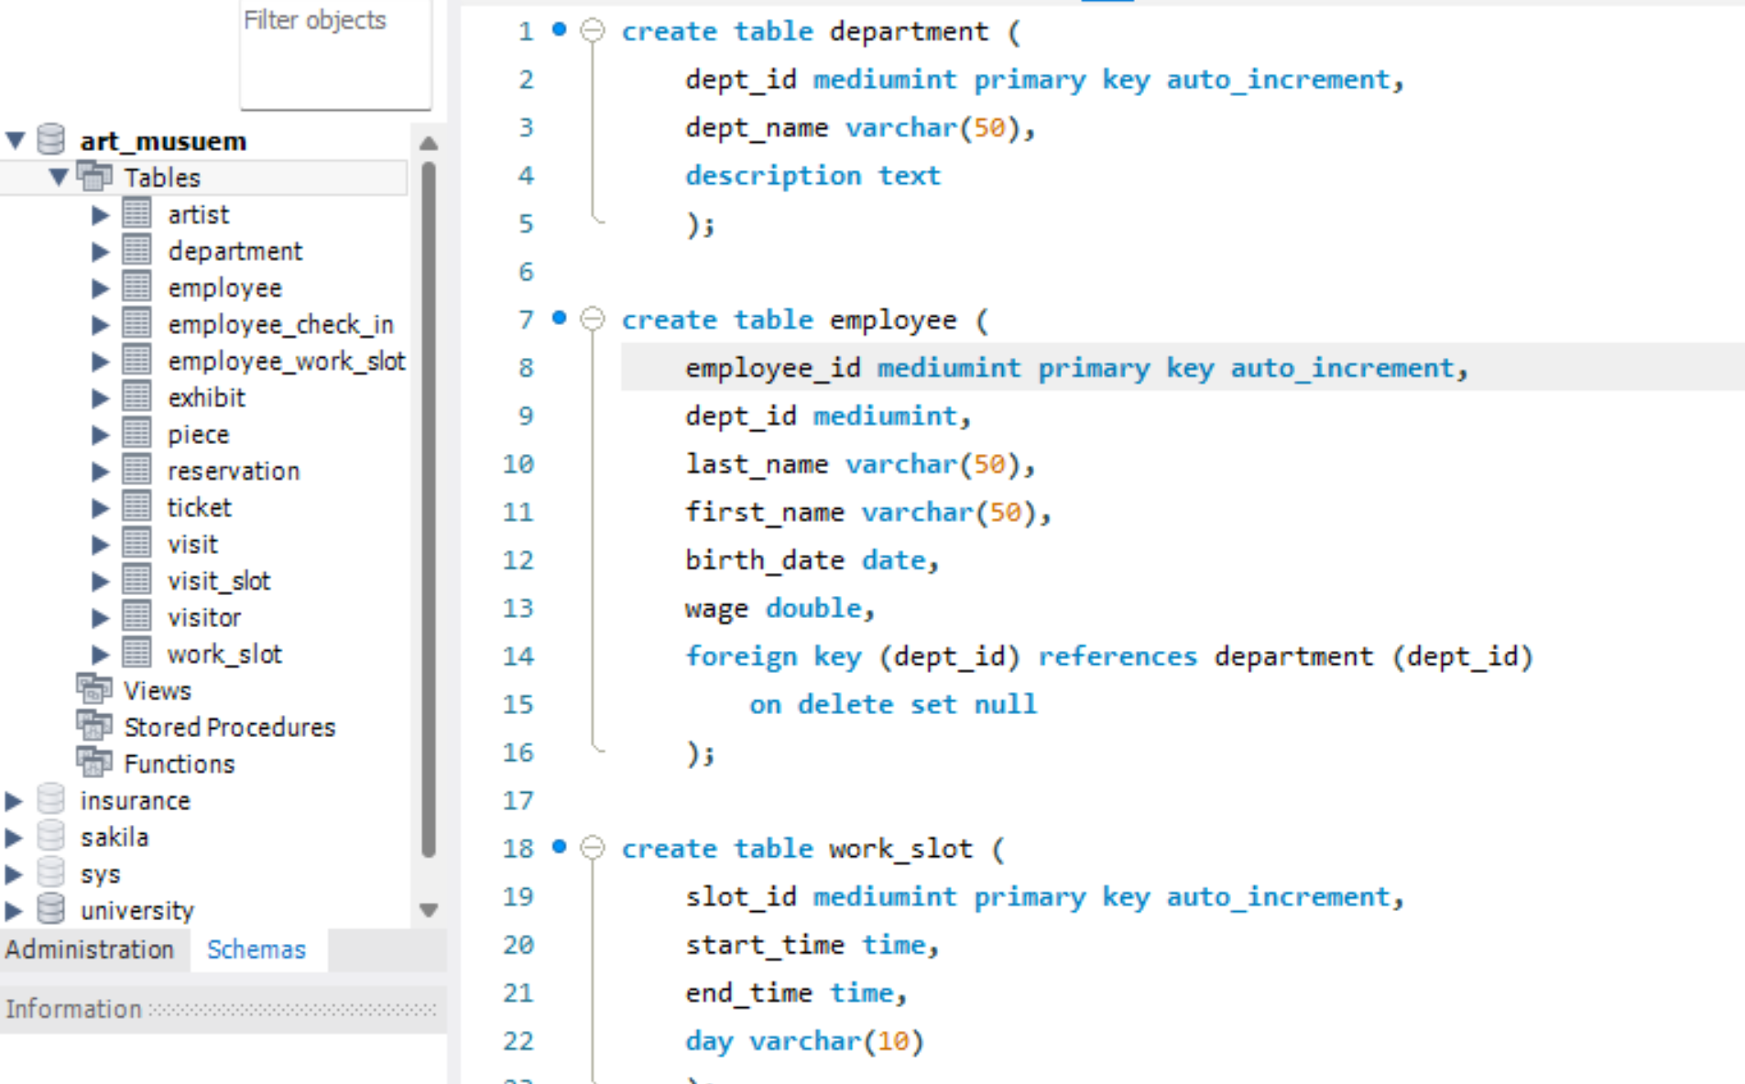
Creating the Database
Snippet of the SQL code on the right for creating the tables
Final tables on the left

Slide 4
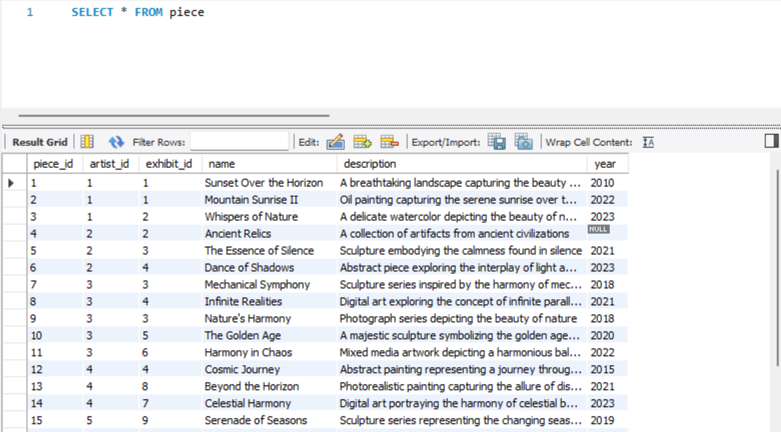
Art Piece Table

Slide 5
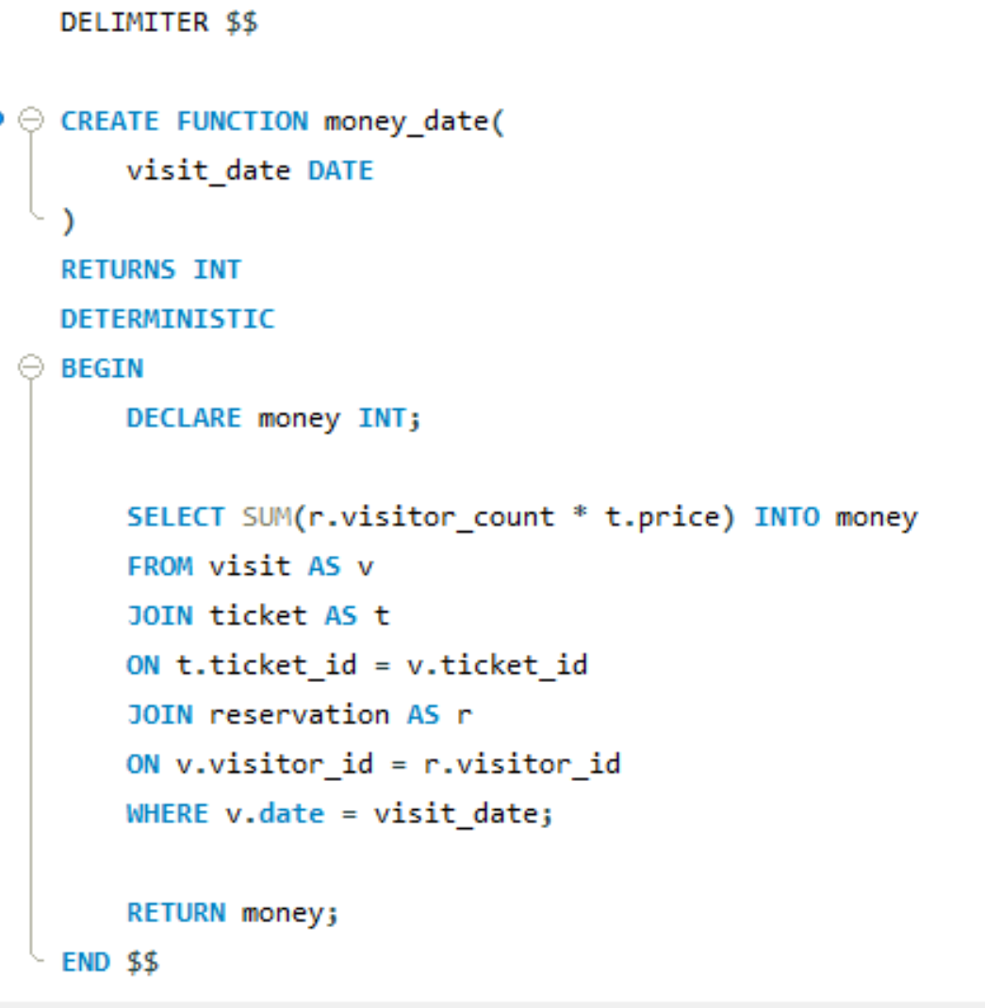
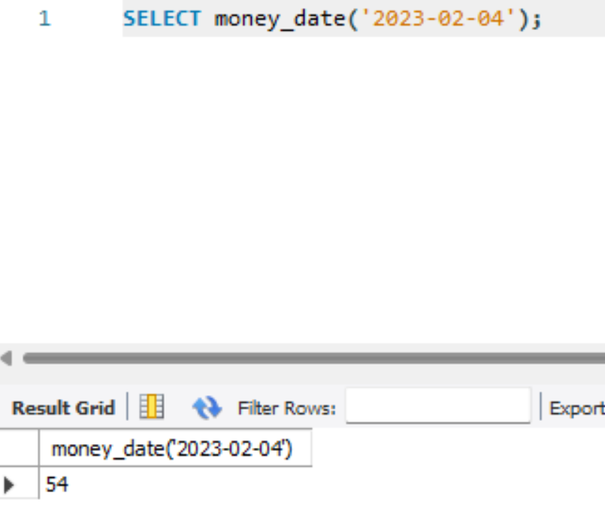
Function: Finding Money Earned per Day

Slide 6
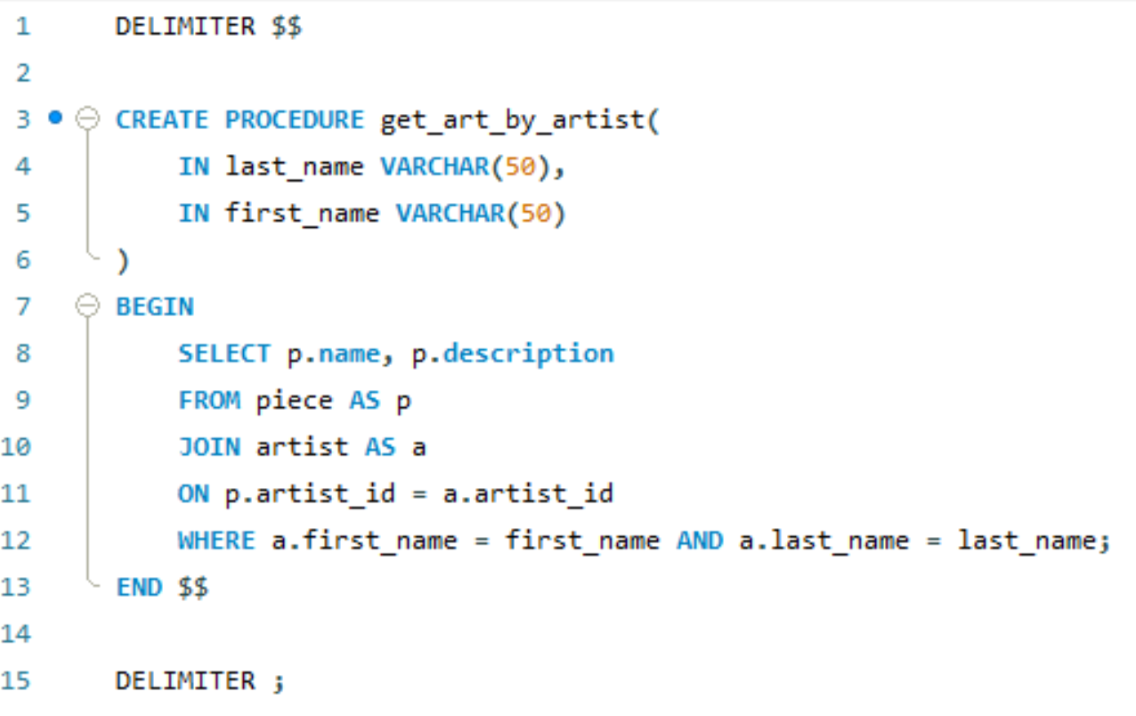
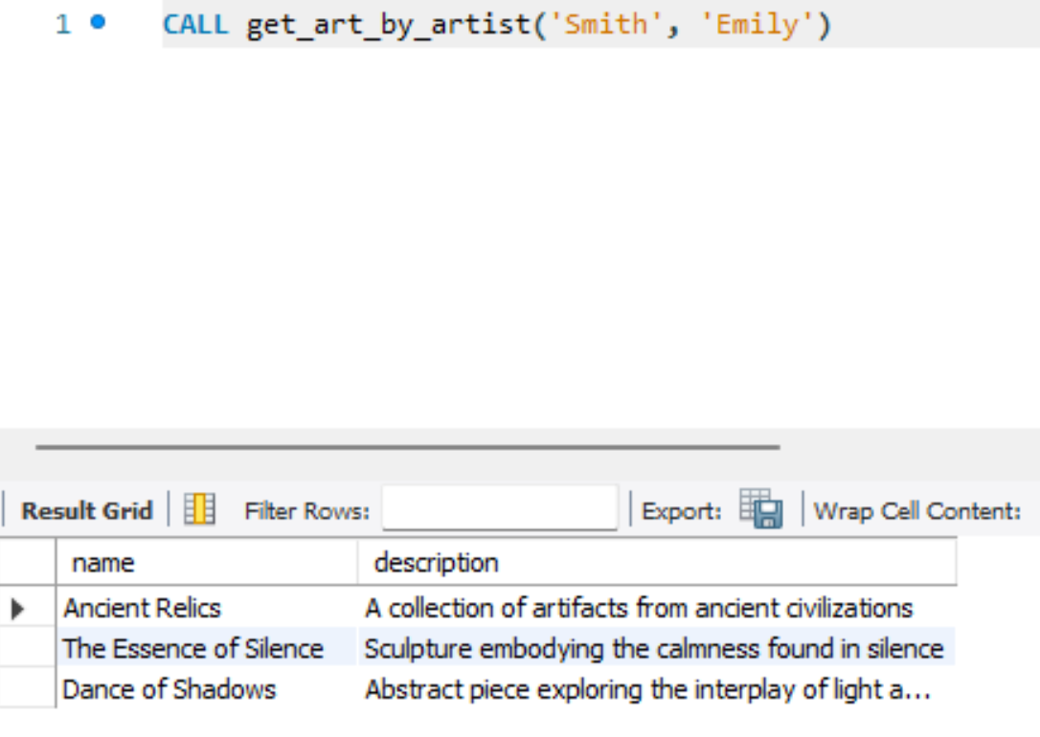
Stored Procedure: Getting Art Pieces by an Artist

Slide 7
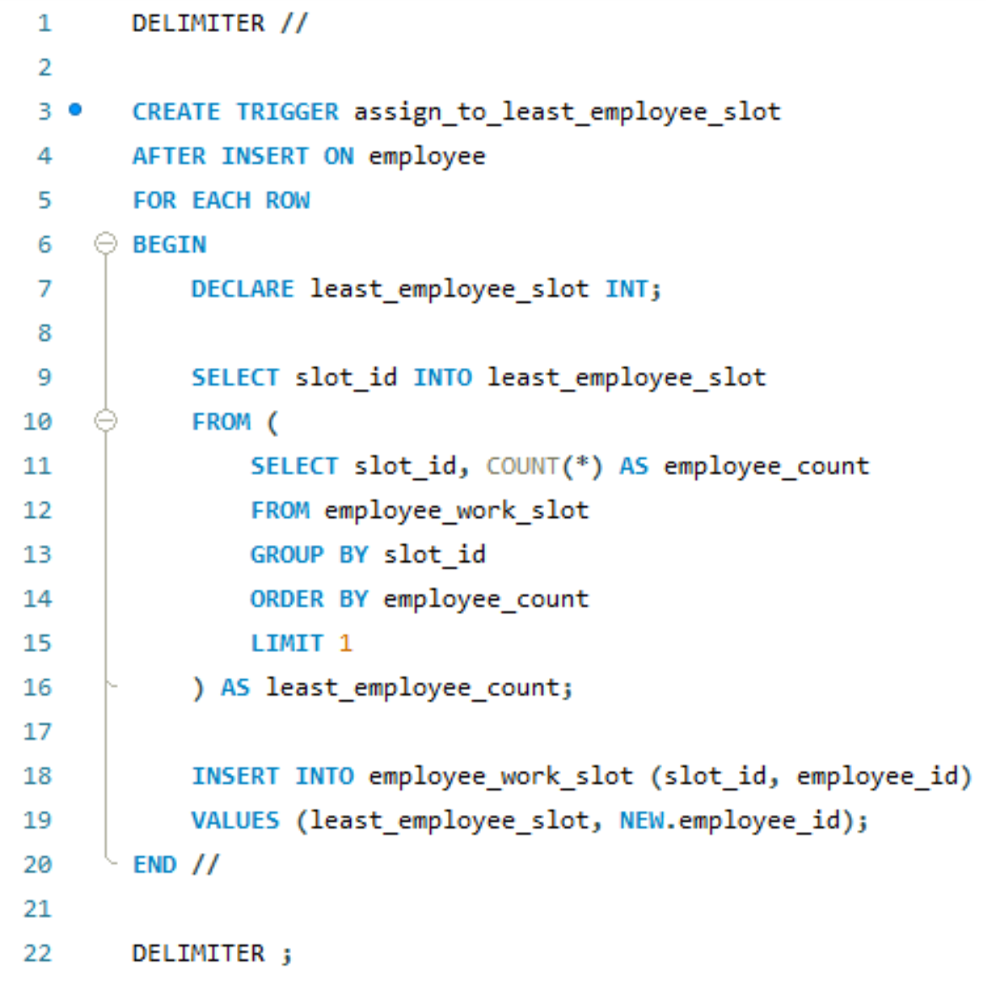
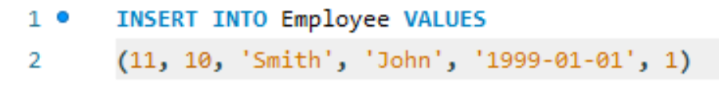
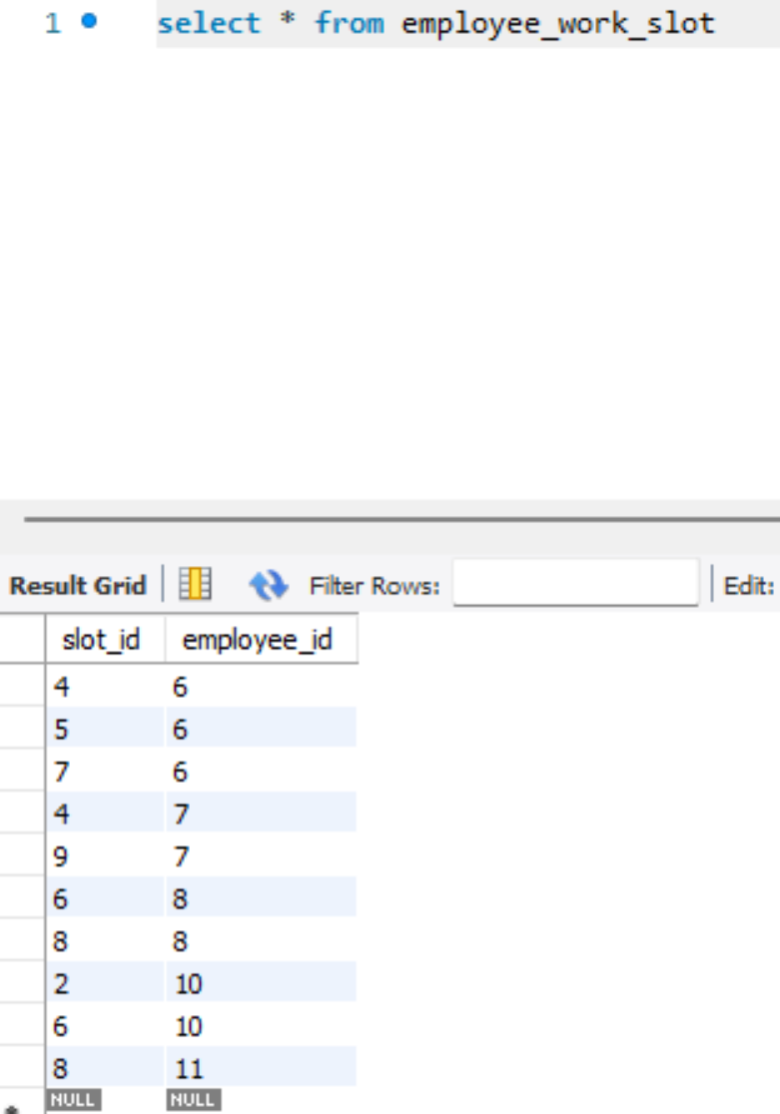
Trigger: Assigning an Employee a Work Slot

Slide 8
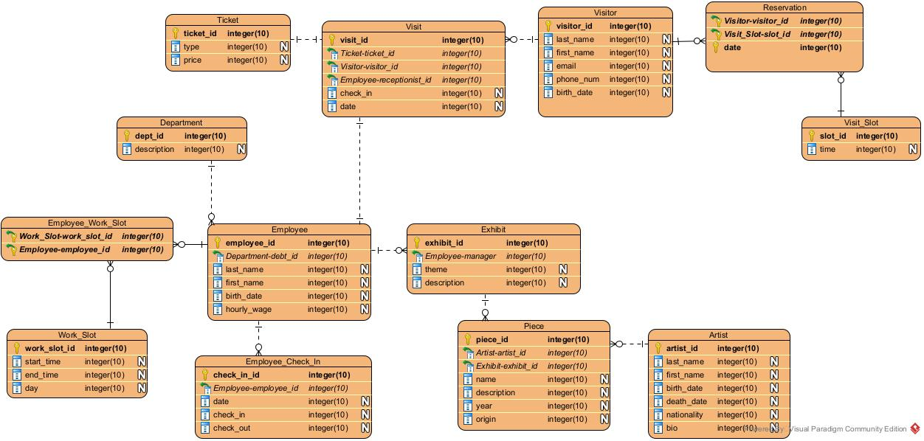
Final ERD

Slide 9
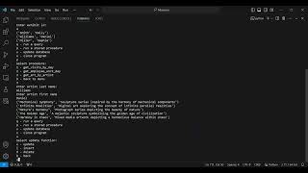
Application Demo

Slide 10
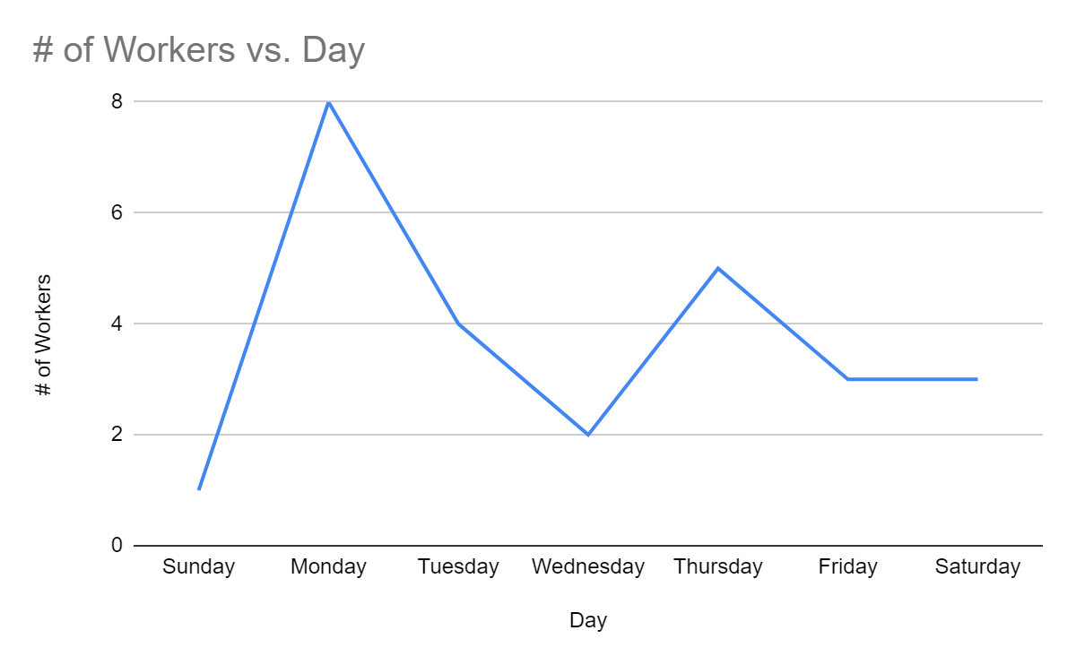
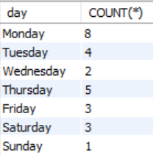
Report 1: Employees Working per Day

Slide 11
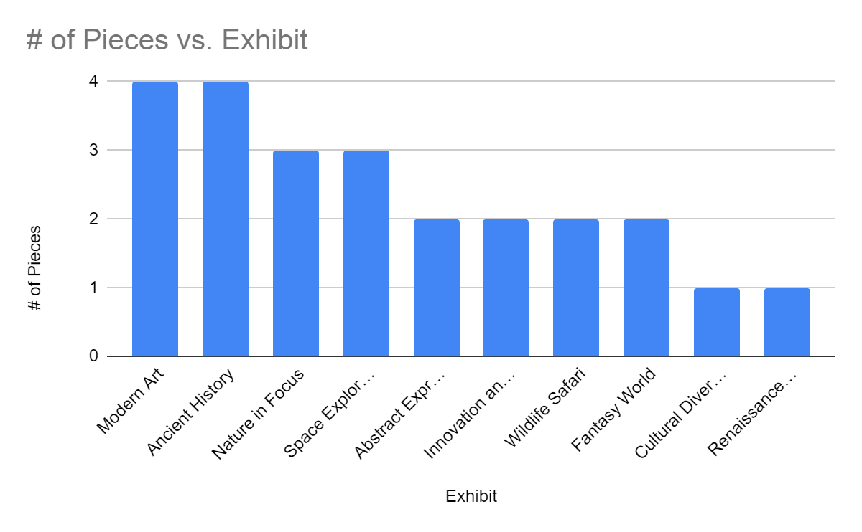
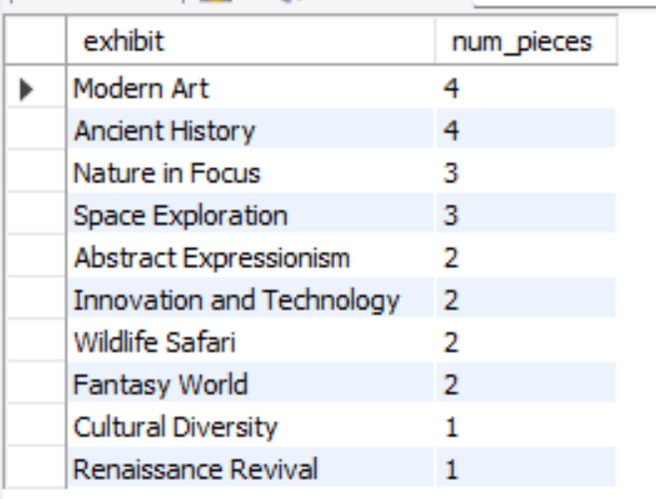
Report 2: Number of Art Pieces per Exhibit

